Slide 1
amazon
By:
Lakhan Wadhwani
Komal Sukheja

Slide 2
01
Mission and Vision
02
Our Founder
03
Company’s Profile
04
Products
Contents
05
Subsidiaries
06
Future Goals
07
Market Share
08
Achievements
09
Sustainability Around the Globe

Slide 3
Mission
We strive to offer “customers with the best prices, the best selection, and the most convenience.”.
Vision
To be Earth’s most customer-centric company, where customers can find and discover anything they might want to buy online

Slide 4
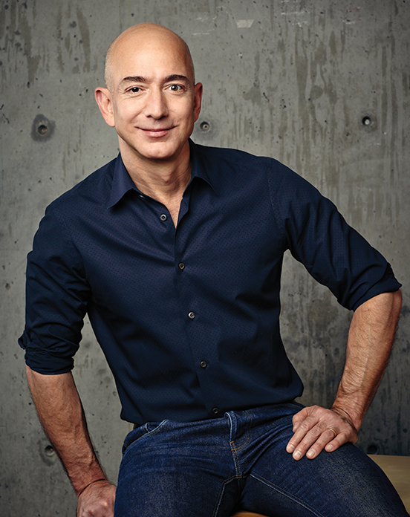
Our Founder
Jeff Bezos is an American entrepreneur, media proprietor, investor, and commercial astronaut. He is the founder, executive chairman, and former president and CEO of Amazon. With a net worth of US$114.5 billion as of November 2022, Bezos is the fourth-wealthiest person in the world and was the wealthiest from 2017 to 2021
JEFF BEZOS
Founder

Slide 5
Company's Profile
American Based Multinational E-Commerce Company
Headquarter in Seattle, Washington
America’s largest online retailer
Founder Jeff Bezos
Founded in 1994, launched it online in 1995 as online bookstore
World’s biggest bookstore with 2.5 Million titles

Slide 6
Products
Books
Movie, Music, Games
Kindle
Computer
Electronics
Grocery, Health, Beauty
Toys, Cloths and Sports
Tools and Industrial

Slide 7





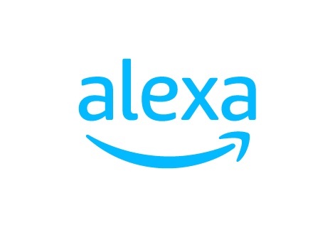

Subsidiaries

Slide 8
Future Goals
On a path to powering their operations with 100% renewable energy by 2025
Make 50% of Amazon shipments net-zero carbon by 2030
Increase representation of employees from diverse backgrounds at every level of our organization
Inspire and empower others to join us on a mission to reach net-zero carbon emissions by 2040

Slide 9
Market Share

Slide 10

Achievements
Most Trustworthy Company of the Fortune 100, 2016
Interbrand Best Global Brand, 2020
Fortune World’s Most Admired Companies, 2017-2021
Boston Consulting Group’s Most Innovative Companies, 2020
Forbes World’s Most Valuable Brands, 2019-2020
Fast Company World’s Most Innovative Companies, 2017-2018

Slide 11
Sustainability Around the Globe

Slide 12
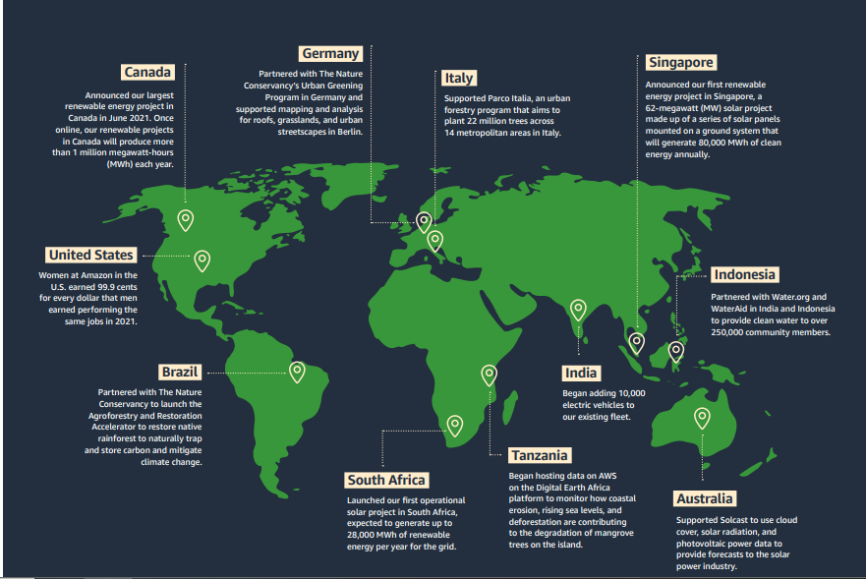

Slide 13
Thanks!

